Slide 1
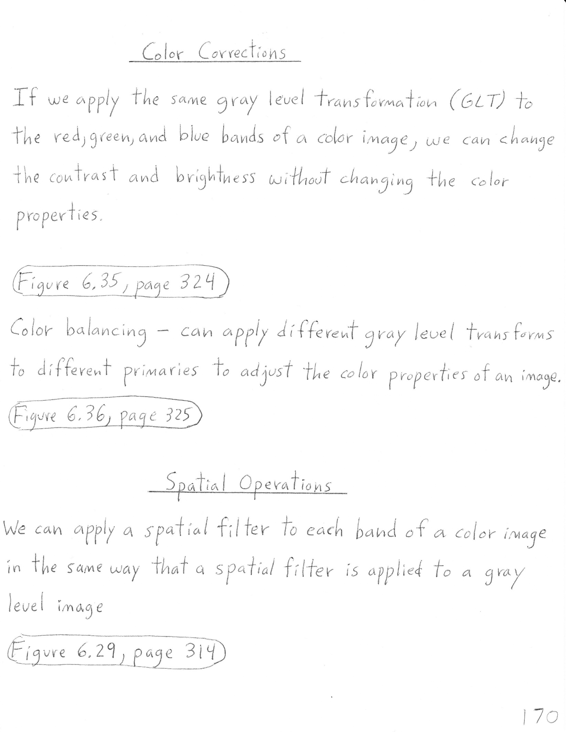

Slide 2
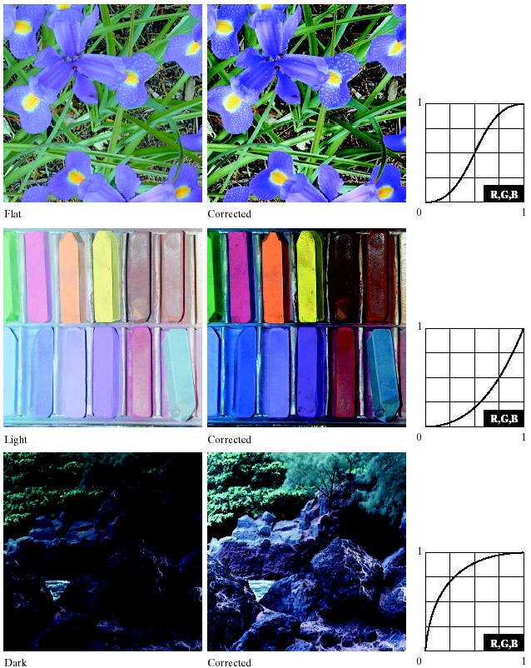


Slide 4
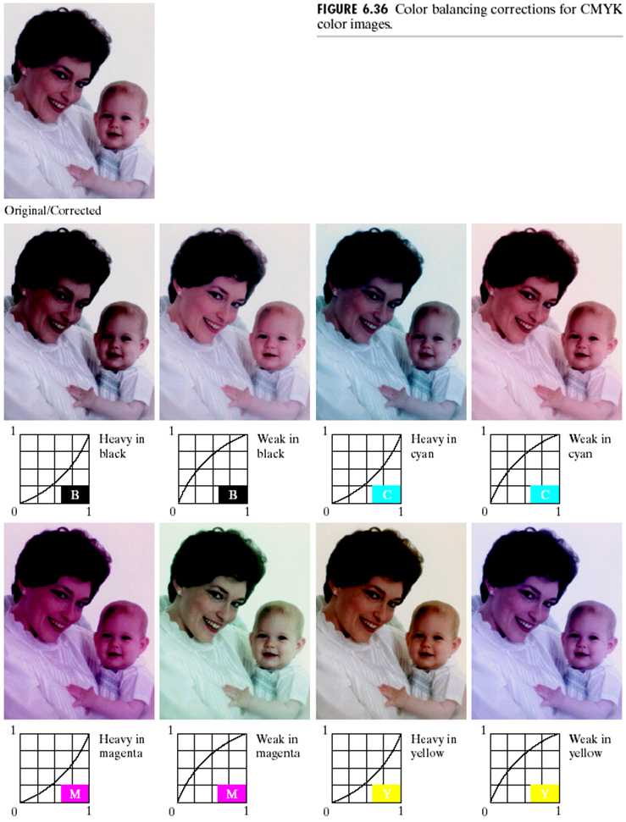

Slide 5


Slide 7
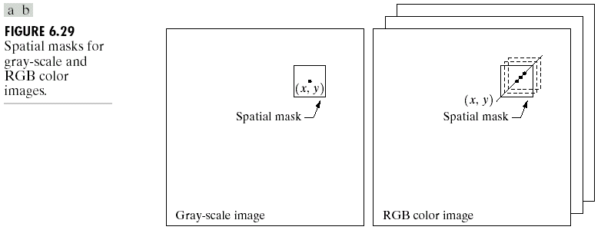

Slide 8
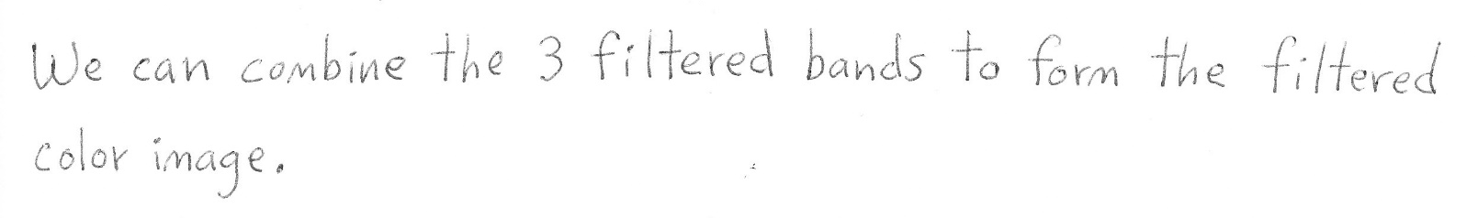

Slide 9
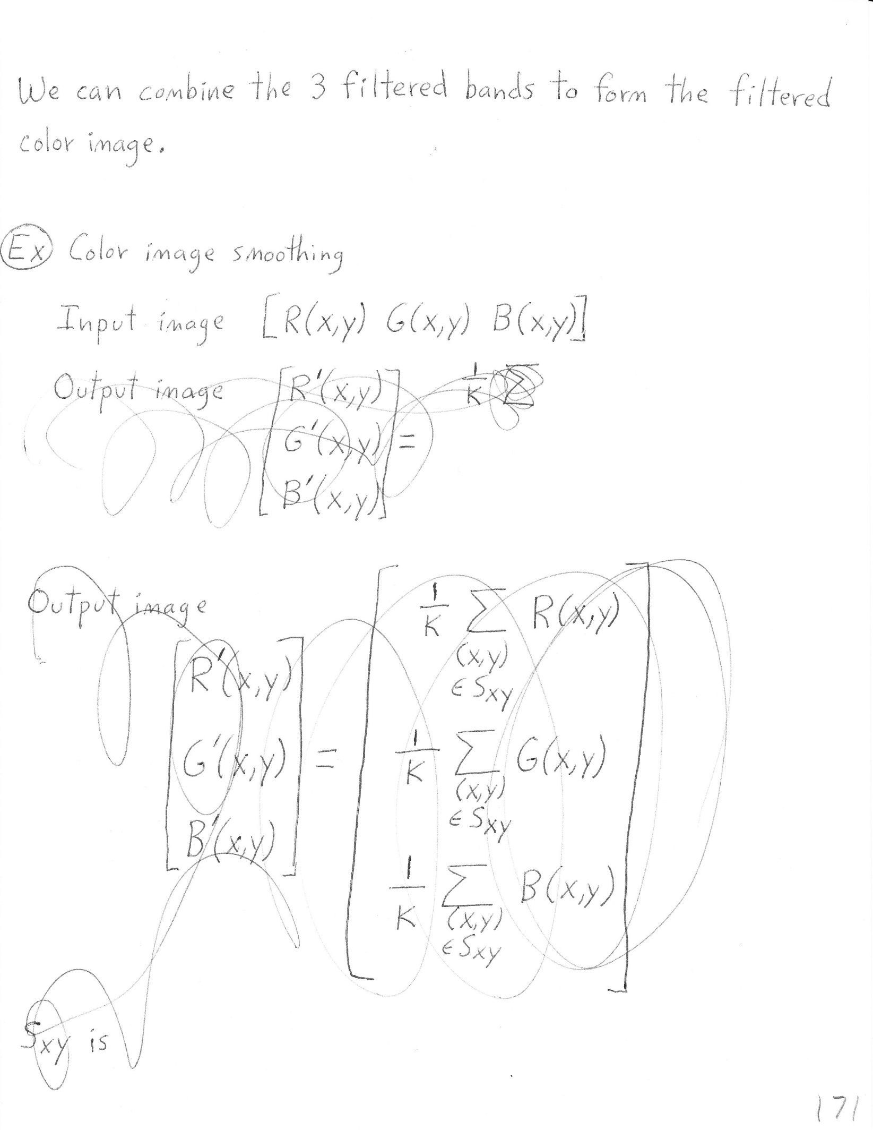
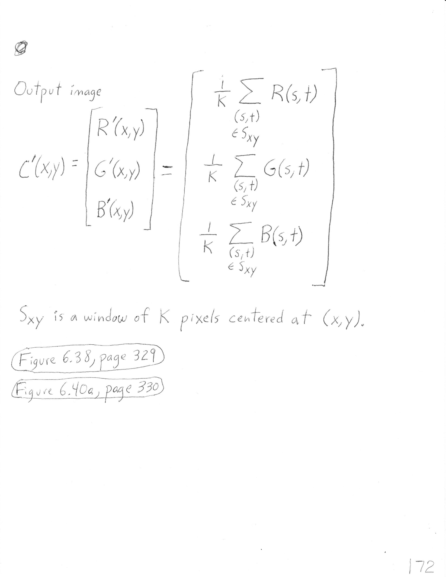

Slide 10
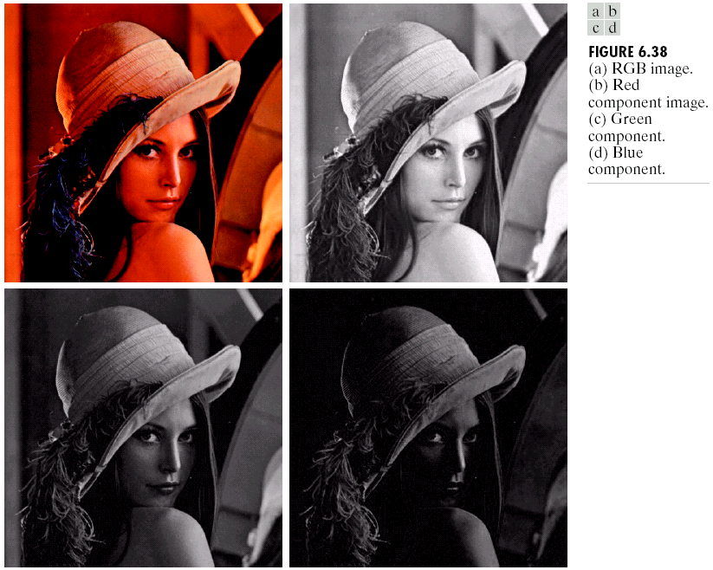

Slide 11

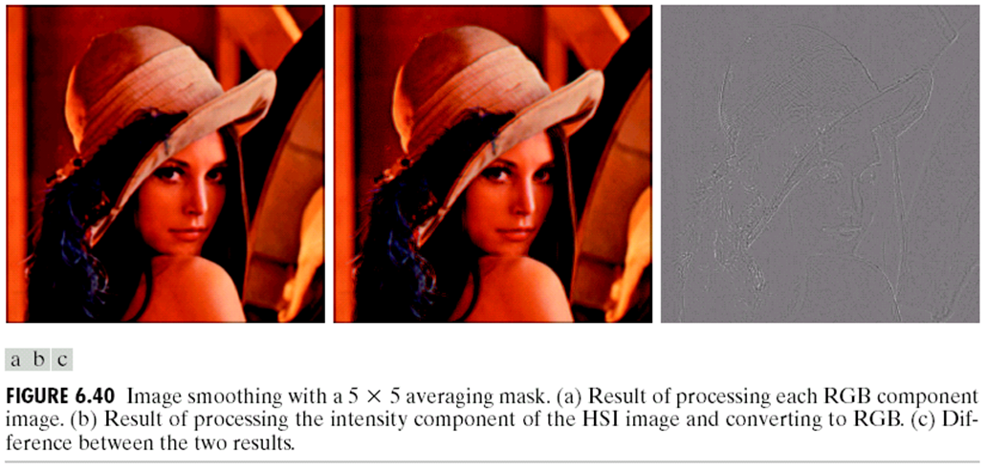


Slide 12
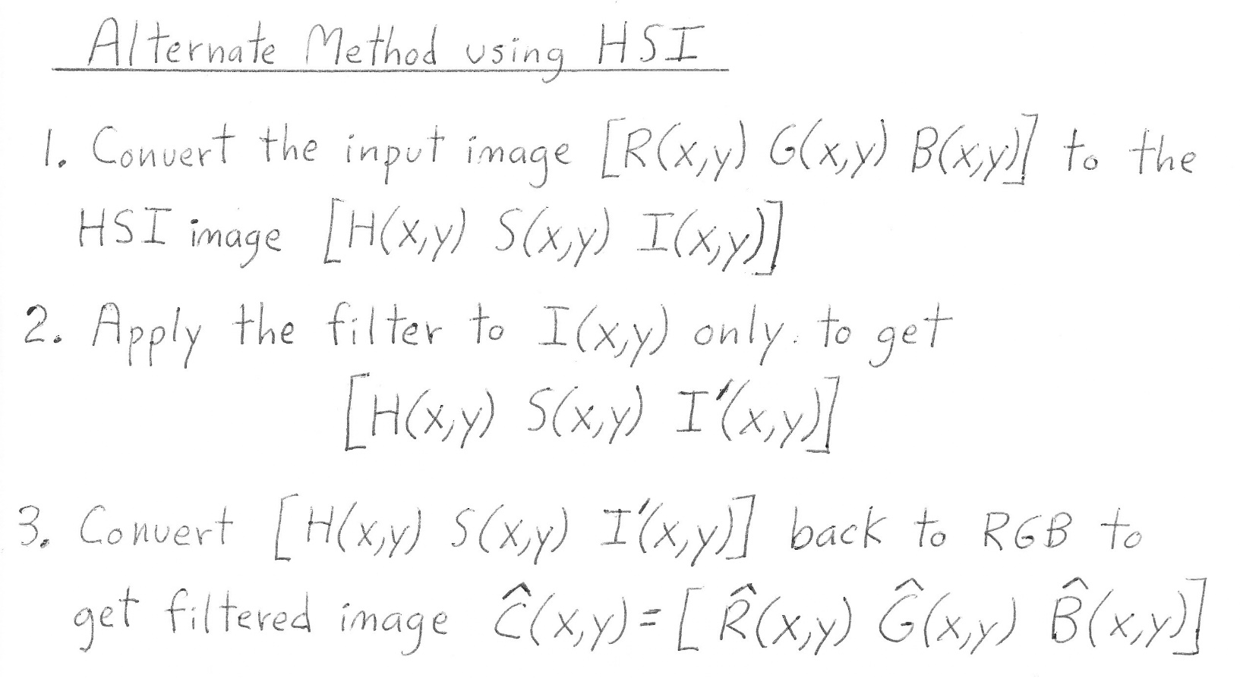

Slide 13
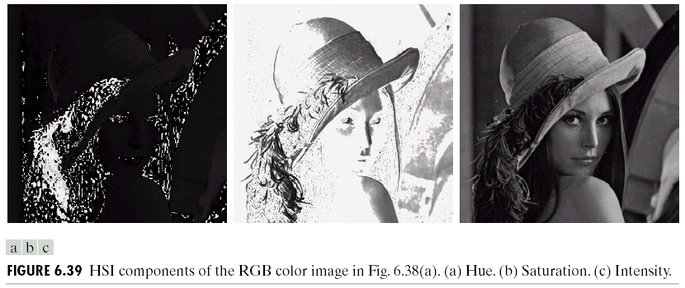

Slide 15
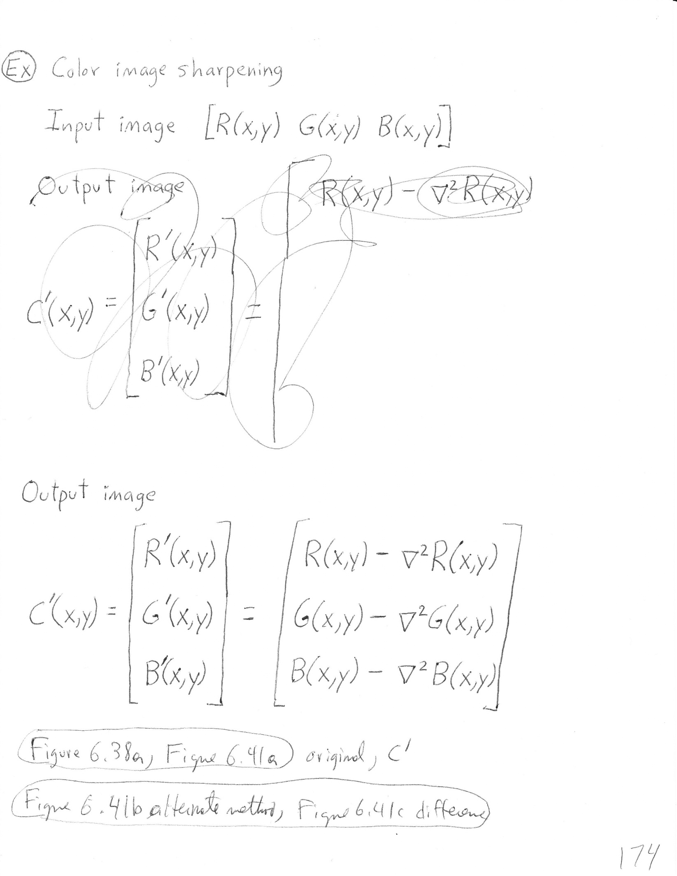

Slide 16
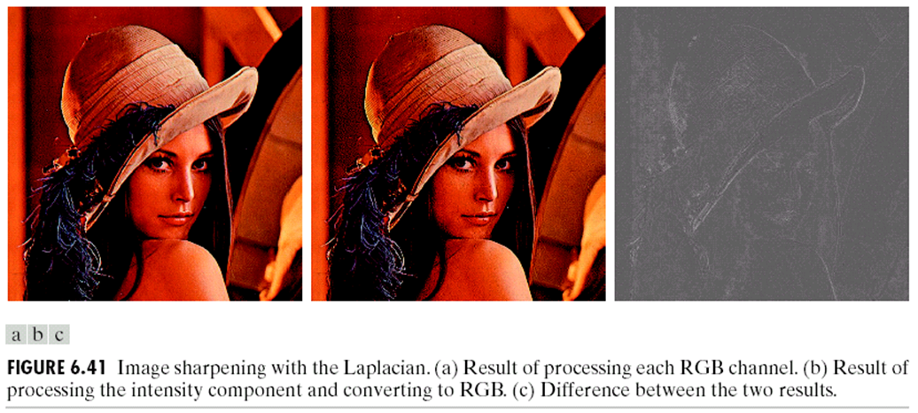


Slide 18
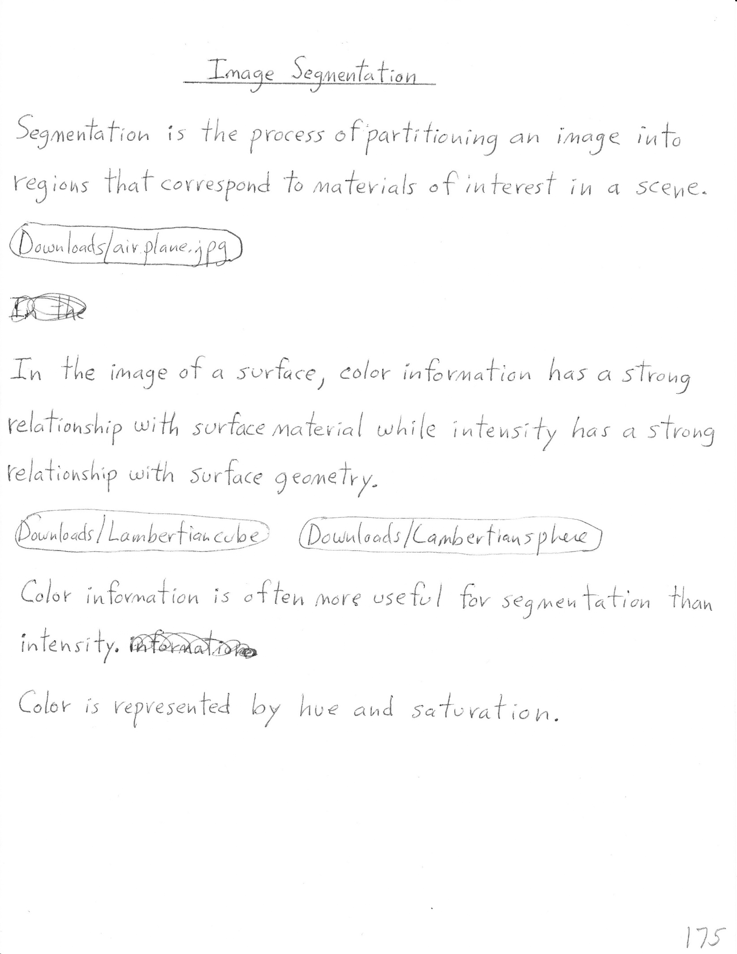

Slide 19
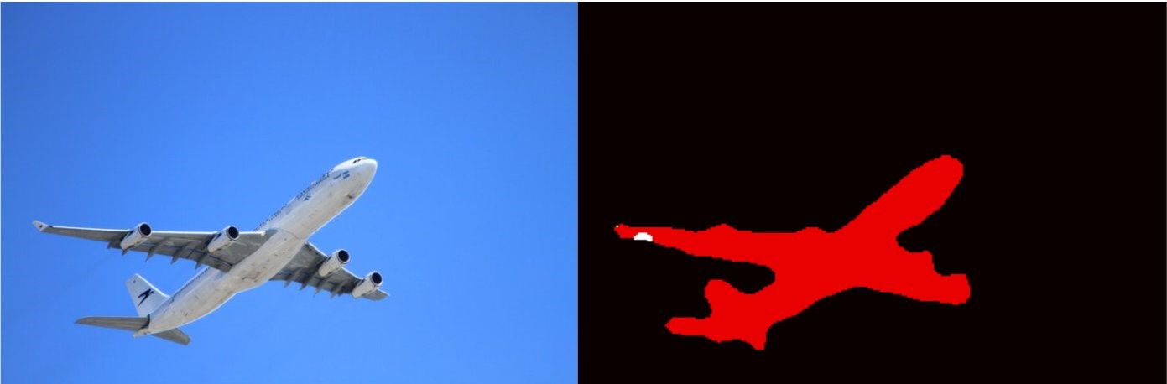

Slide 21

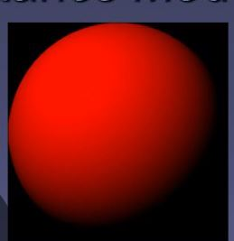

Slide 22
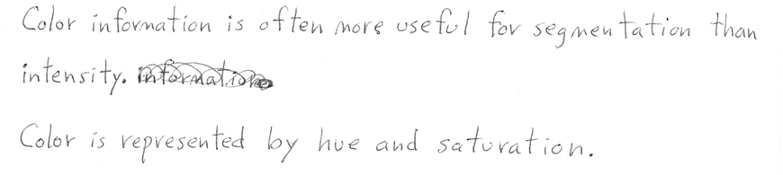


Slide 23


Slide 24
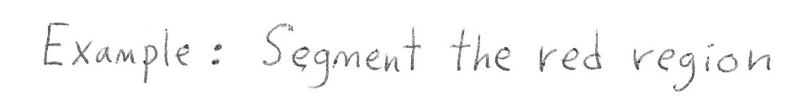
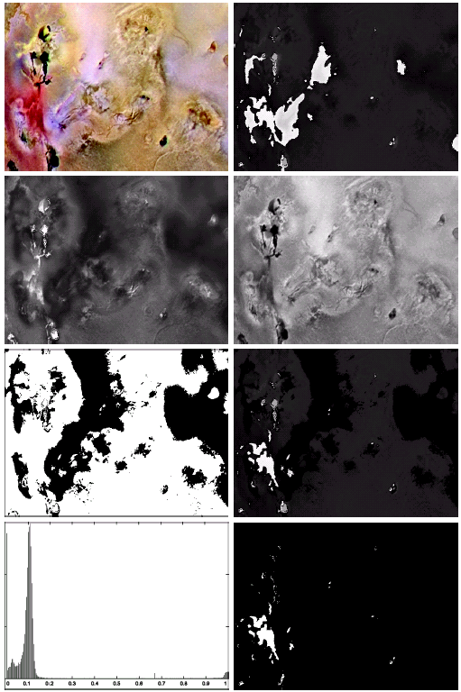
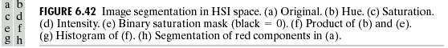

Slide 25
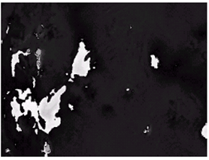
Hue H(x,y)

Slide 26
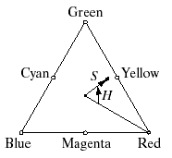
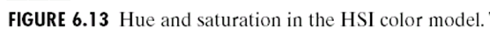
Hue H(x,y)

Slide 27
Hue H(x,y)
Saturation S(x,y)
Intensity I(x,y)

Slide 28


Slide 29
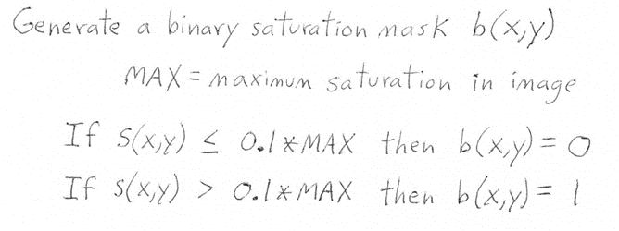

Slide 30
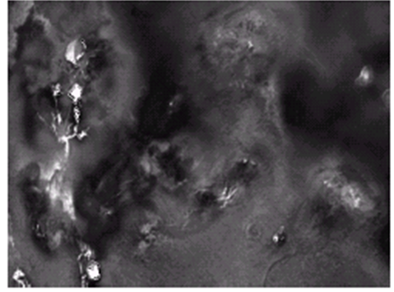
Saturation S(x,y)
Binary Saturation Mask b(x,y)

Slide 31
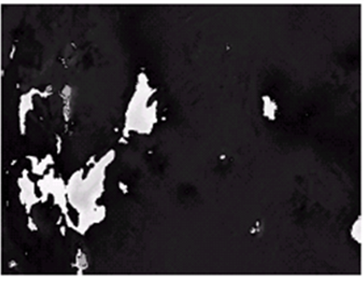
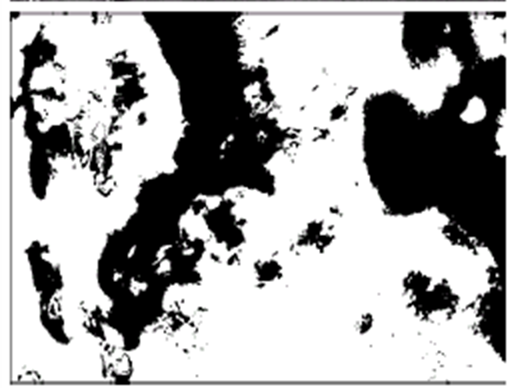
Hue H(x,y)
Binary Saturation Mask b(x,y)

Slide 32
Hue H(x,y)
Binary Saturation Mask b(x,y)
H(x,y)b(x,y)

Slide 33
Hue H(x,y)
Binary Saturation Mask b(x,y)
H(x,y)b(x,y)
Histogram of H(x,y)b(x,y)

Slide 34
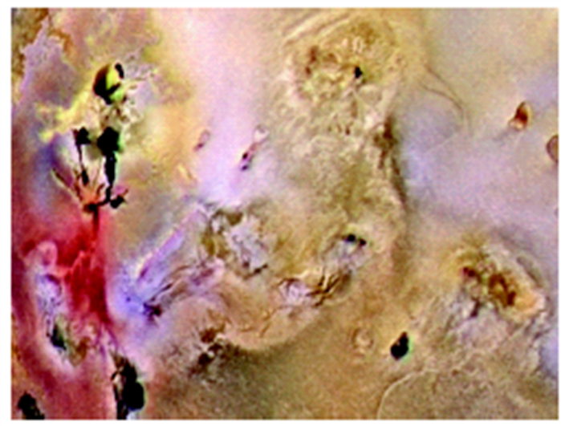
Input Color Image
Threshold H(x,y)b(x,y) at 0.9

Slide 35
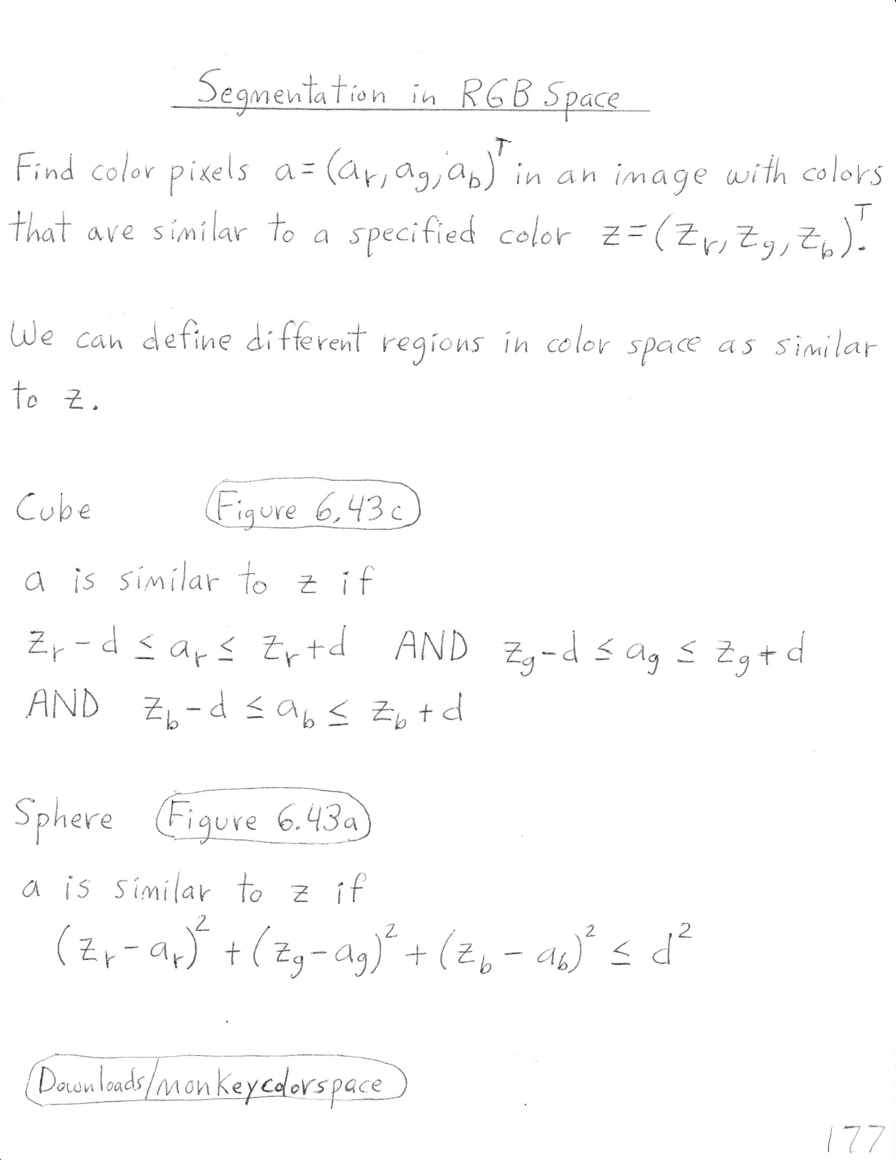

Slide 36
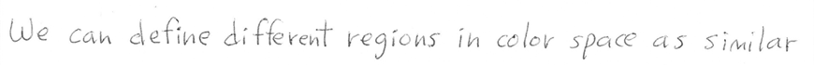
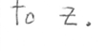

Slide 37
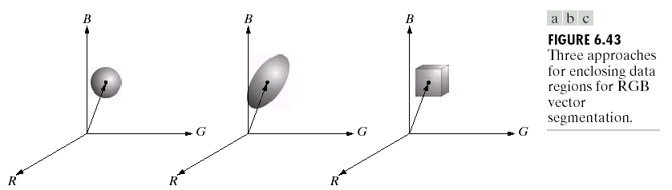
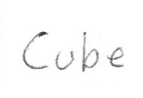
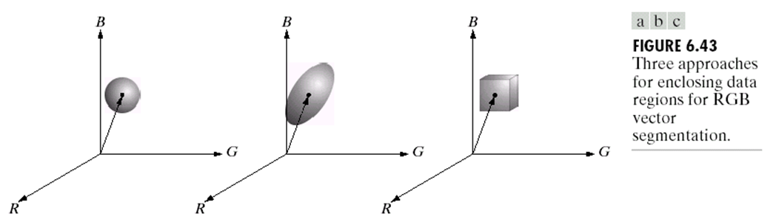

Slide 39
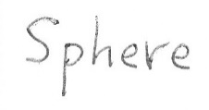
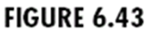

Slide 40


Slide 41
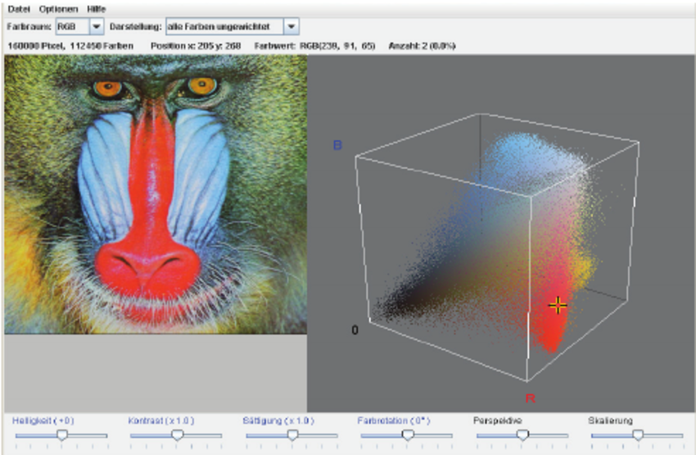

Slide 42
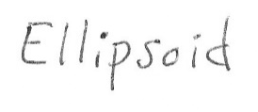

Slide 43
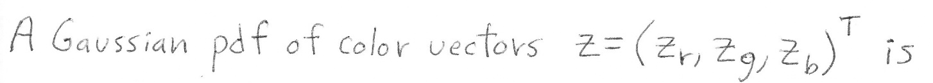
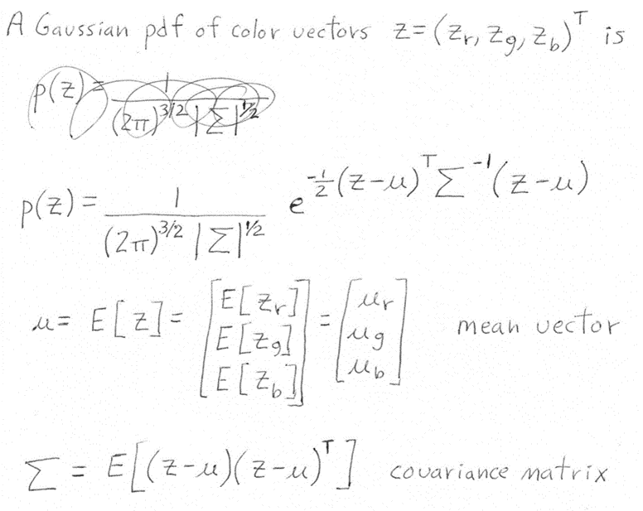

Slide 46
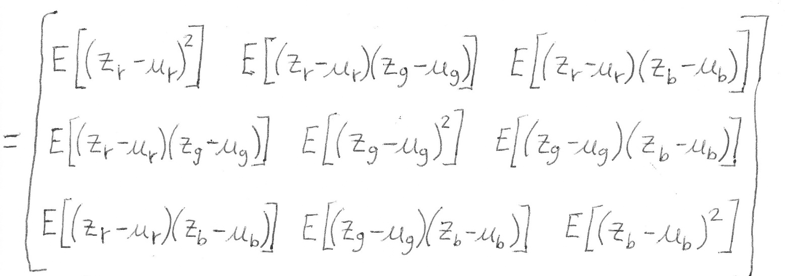

Slide 47
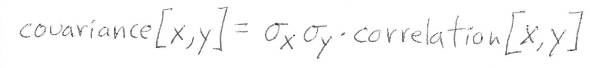
(covariance and correlation have the same sign)

Slide 48
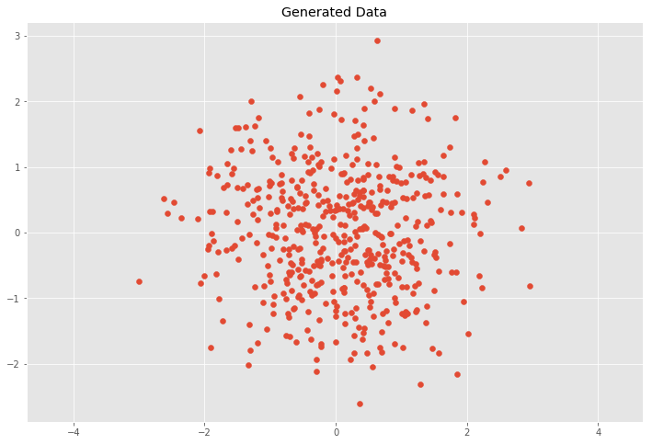
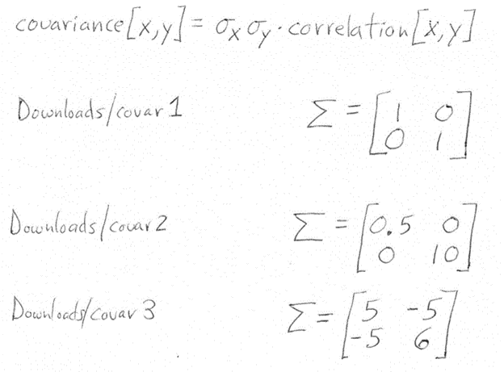
(covariance and correlation have the same sign)

Slide 49
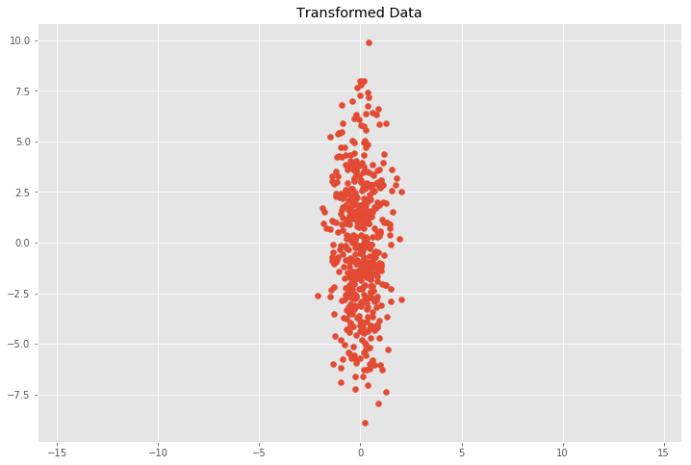
(covariance and correlation have the same sign)

Slide 50
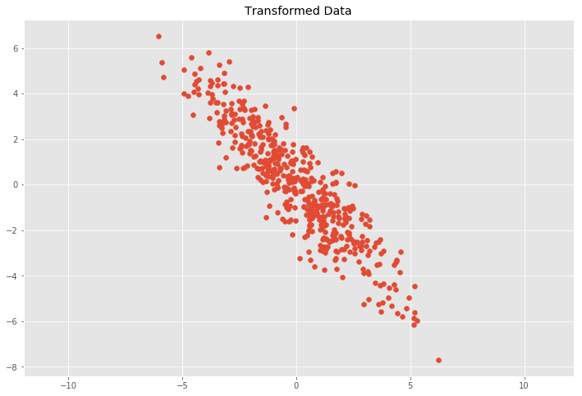

Slide 51
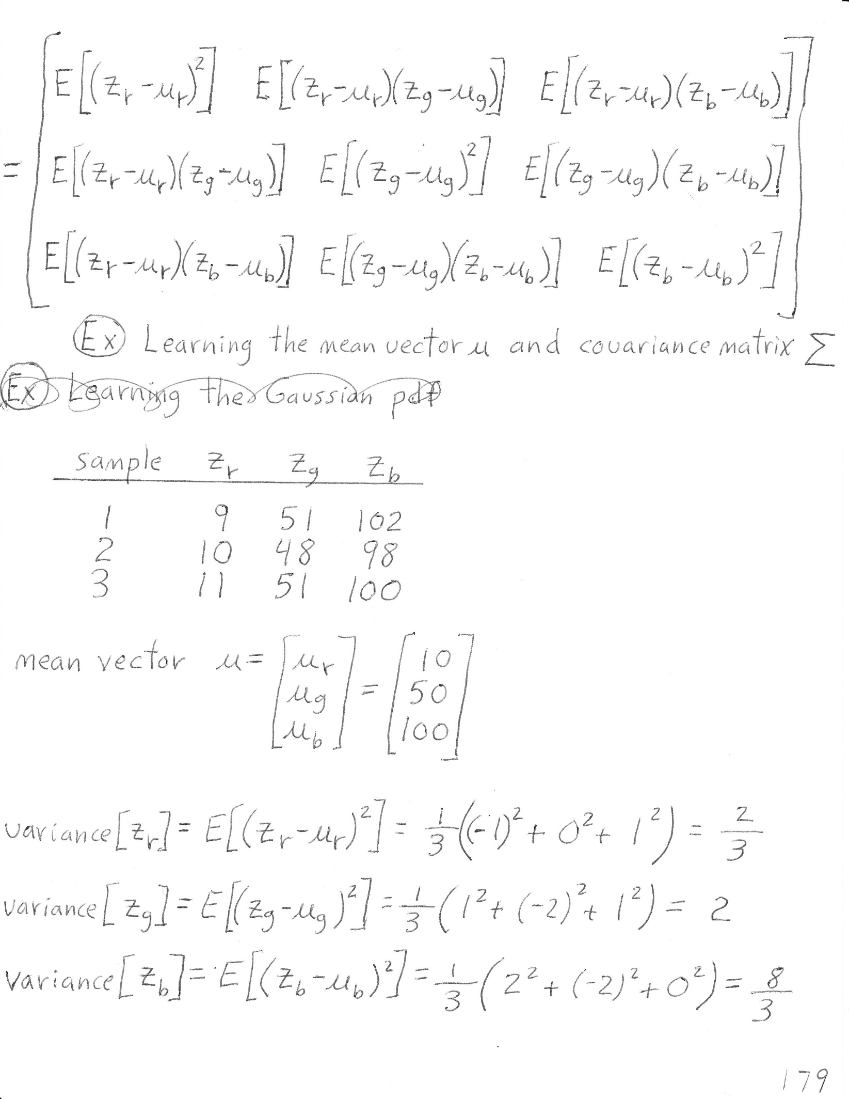


Slide 52
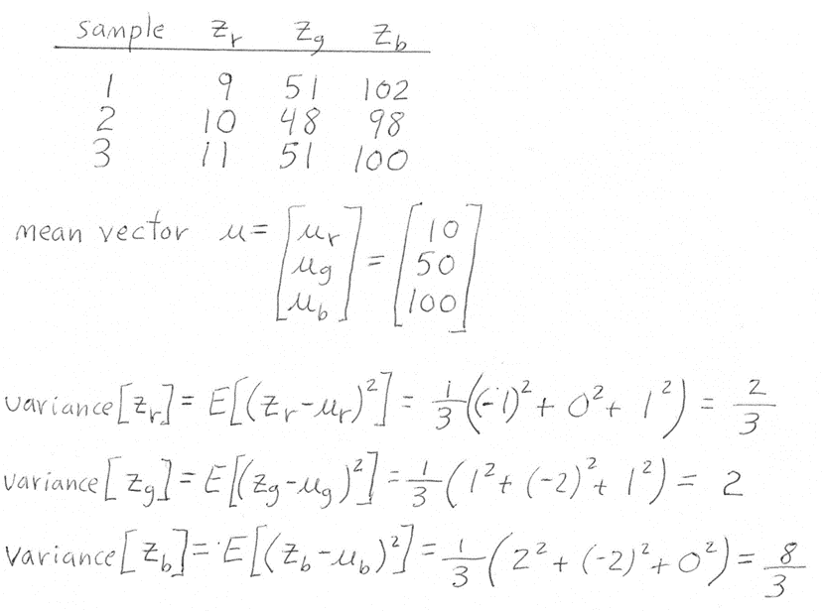

Slide 54
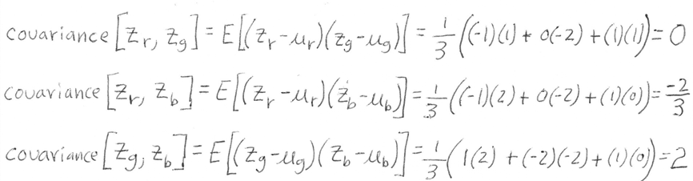

Slide 55
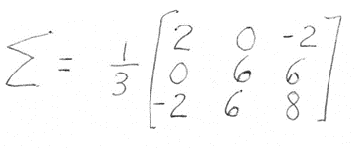

Slide 56



Slide 57



Slide 58


Slide 60


Slide 61


Slide 62


Slide 63


Slide 65


Slide 66


Slide 67



Slide 68


Slide 69
Point 1 a=(-1,-1)

Slide 70

Point 1 a=(-1,-1)

Slide 71

Point 1 a=(-1,-1)

Slide 72
Point 1 a=(-1,-1)

Slide 73
Point 1 a=(-1,-1)
Point 2 a=(-1,1)

Slide 74

Point 1 a=(-1,-1)
Point 2 a=(-1,1)

Slide 75

Point 1 a=(-1,-1)
Point 2 a=(-1,1)

Slide 76
Point 1 a=(-1,-1)
Point 2 a=(-1,1)

Slide 77



